Slide 1
Reconstructing Loopy Curvilinear Structures Using Integer Programming
David lee
Michael SEung

Slide 2
Introduction
Curvilinear structures are everywhere!
Issue: “The lack of powerful and effective computational tools to automatically reconstruct neuronal arbors has emerged as a major technical bottleneck in neuroscience research”
Can we get graphs from images of curvilinear (loopy) structures? (or at least what appear to be curvilinear)

Slide 3
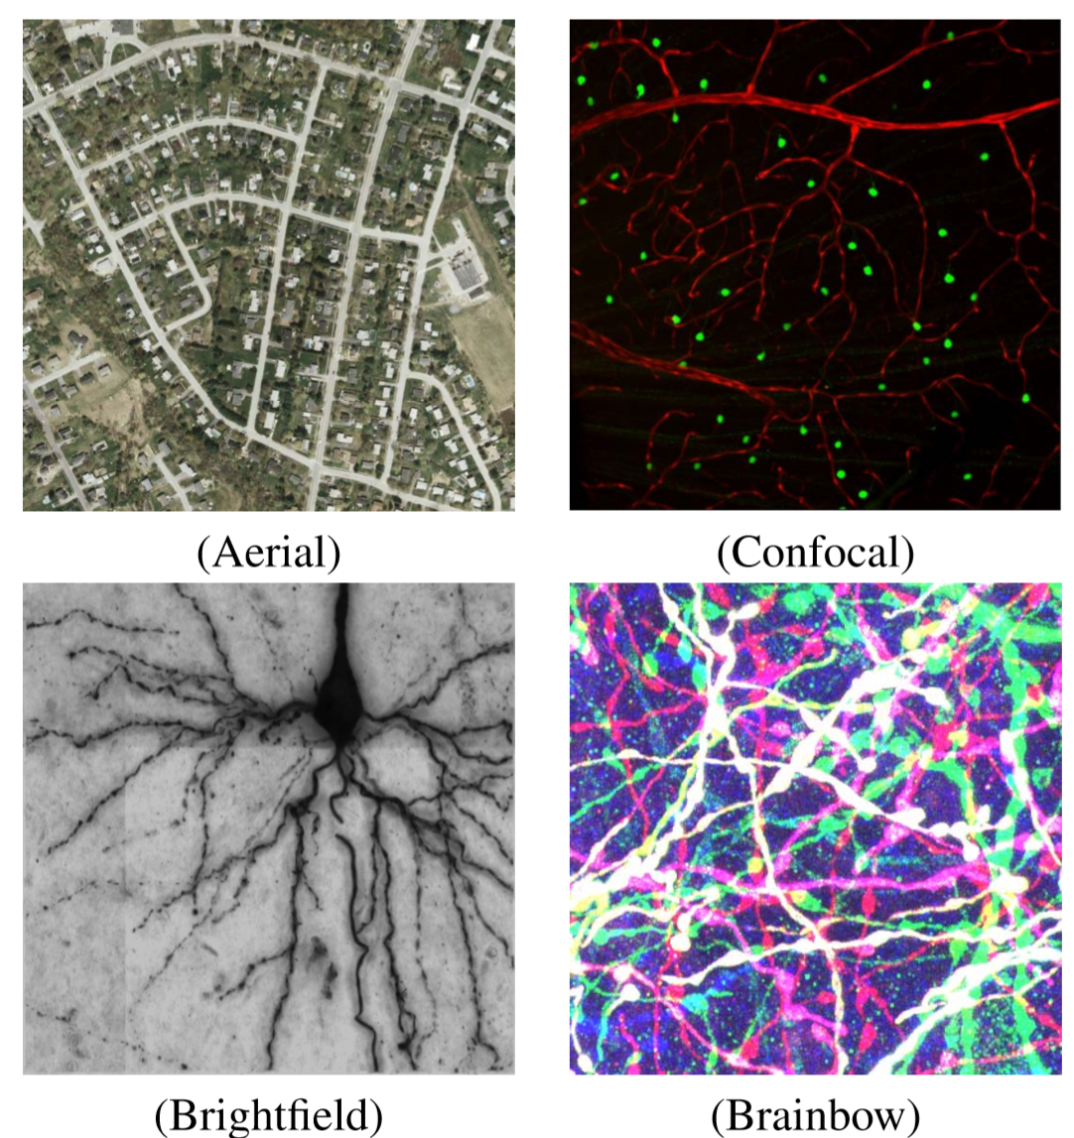
Some loopy images
Truly
Loopy!
Look Loopy but actually aren’t loopy

Slide 4
Current Challenges
Low imaging resolution in Z-axis
Branches appear to cross
Many methods have a strict tree constraint

Slide 5
Trees vs Loops
Trees have branches!
Loops have cycles
Some images (i.e. neurons) are truly trees, but look like they have loops when imaged
Sometimes its better to treat them as loops instead of trees

Slide 6
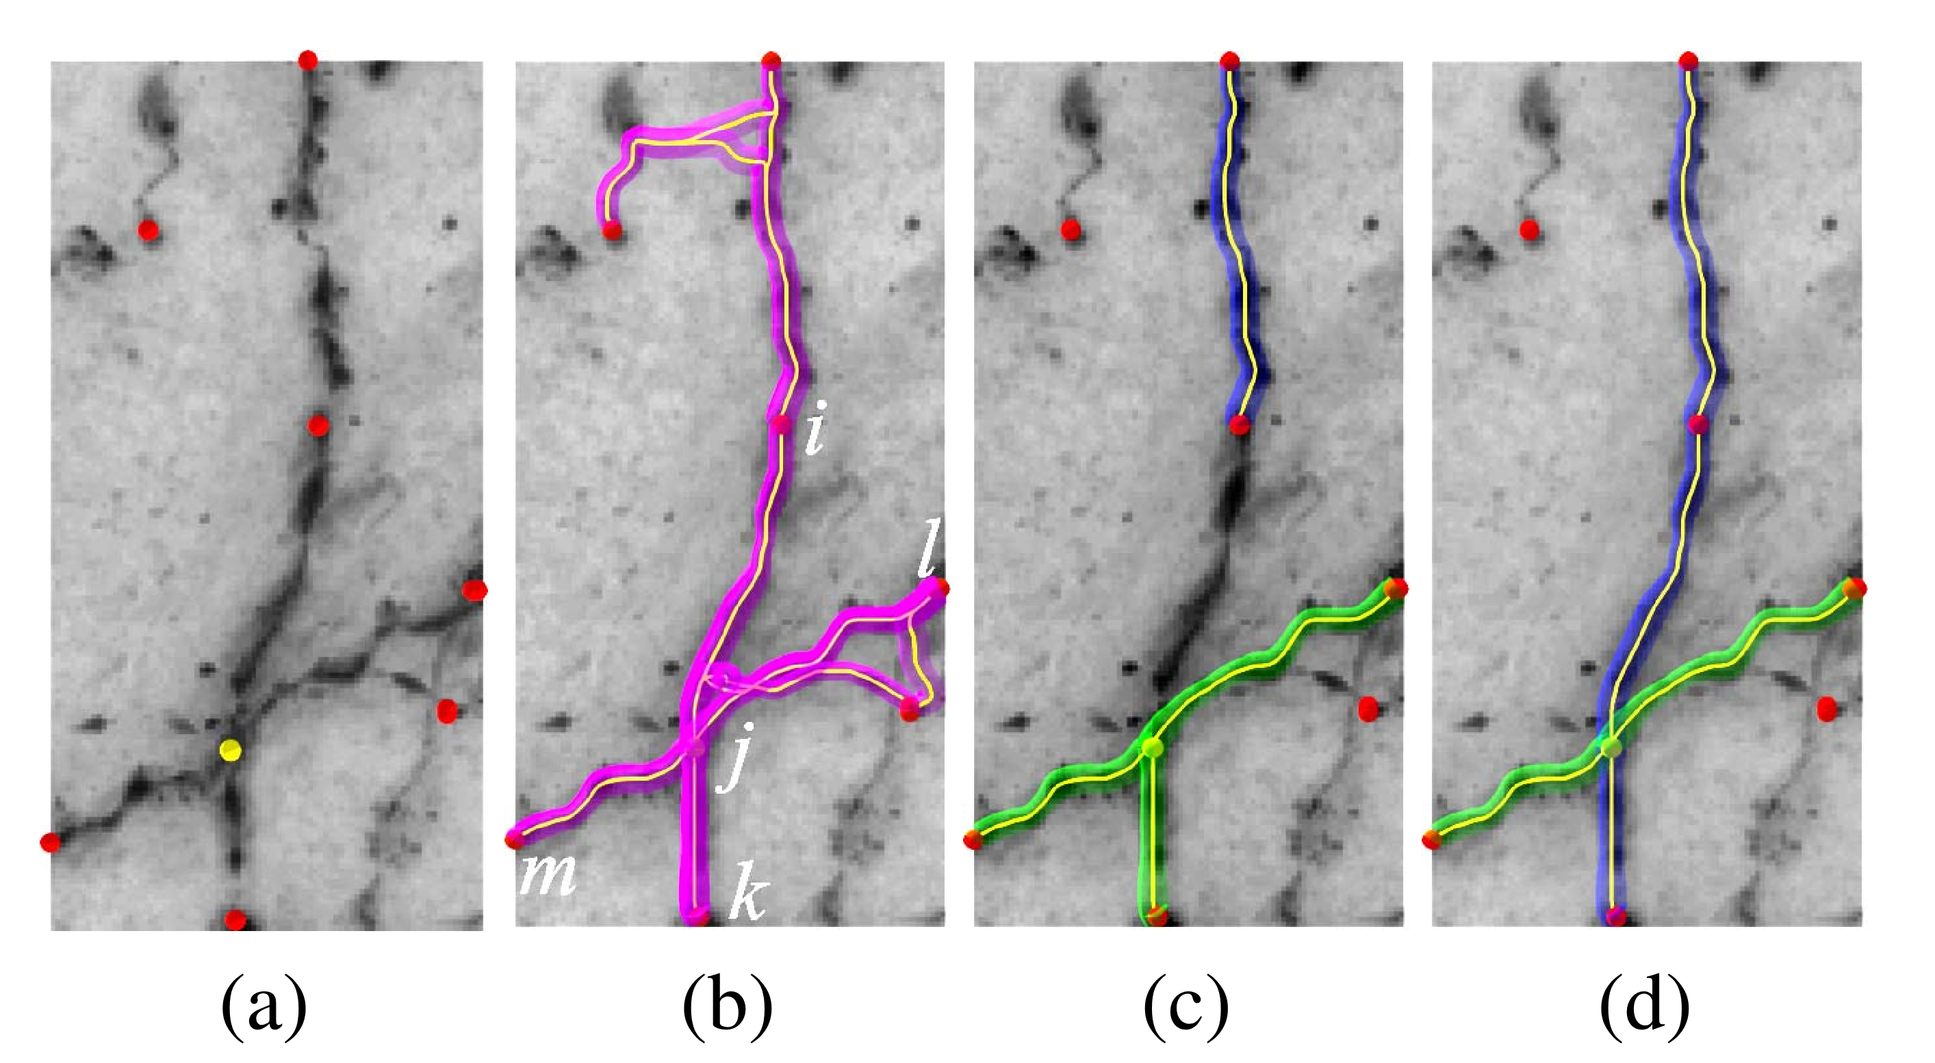
Why loops might be better
Dots shown are sample points (seeds)
(c) Sample points are not used more than once
(d) Yellow point (shown in (a)) is used twice

Slide 7
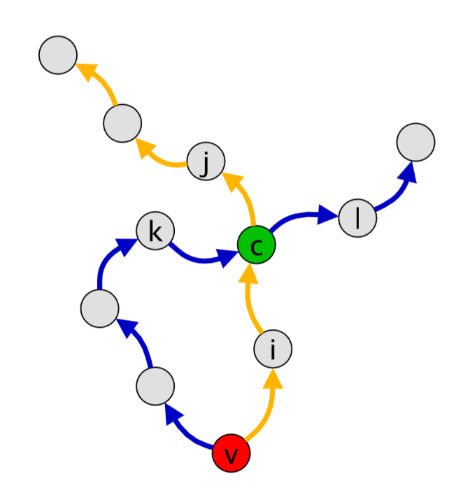
A Loopy Graph

Slide 8
Nodes and Edges Defined
G = (V,E)
V = {v_{i}}
E = {e_{ijk} = (e_{ij},e_{jk})}-> Consecutive edge pairs
Edge pairs(e_{ic},e_{cj})and (e_{kc},e_{cl}) should belong but neither (e_{ic},e_{cl}) nor (e_{kc},e_{cj}).

Slide 9
Edge pairs (e_{ij}, e_{jk})and(e_{mj}, e_{jl}) are both active and vertex j belongs to both branches.

Slide 10
Method
Created a weighted graph that is overcomplete
Find objective subgraph using objective function
Graph can have cycles – spurious junctions and early branch terminations are penalized

Slide 11
Method
Let X = {X_{ijk}} be the vector of binary random variables denoting whether edge pairs {e_{ijk}} truly belong
Let x = {x_{ijk}}the corresponding vector of indicator variables.
e_{ijk} is active in the solution if x_{ijk} = 1.

Slide 12
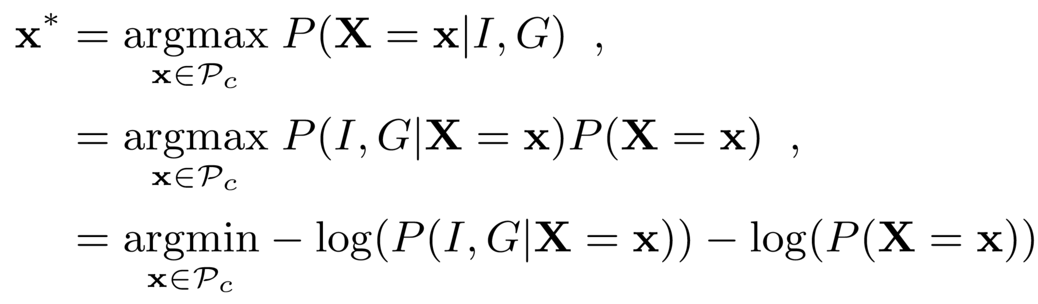
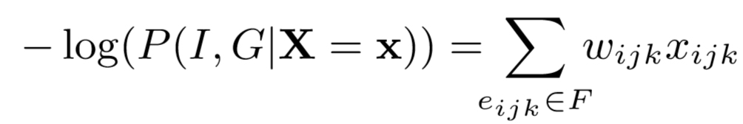
Methods – Objective Function
Given graph G and image evidence I
1st log likelihood term simplifies to
Minimize sum of two negative log likelihood terms
Where w_{ijk} is the cost that accounts for the quality of shortest path associated with edge pair e_{ijk}

Slide 13
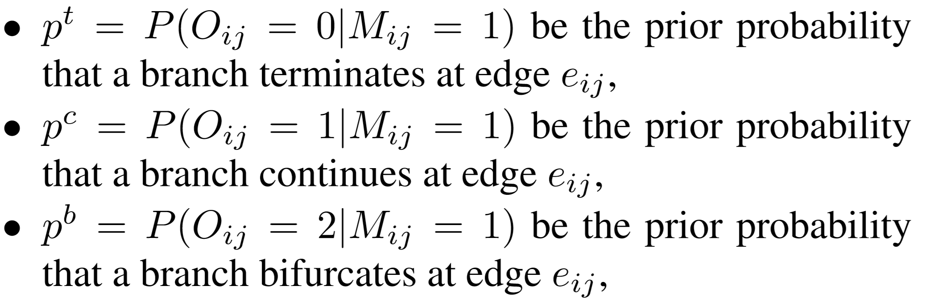
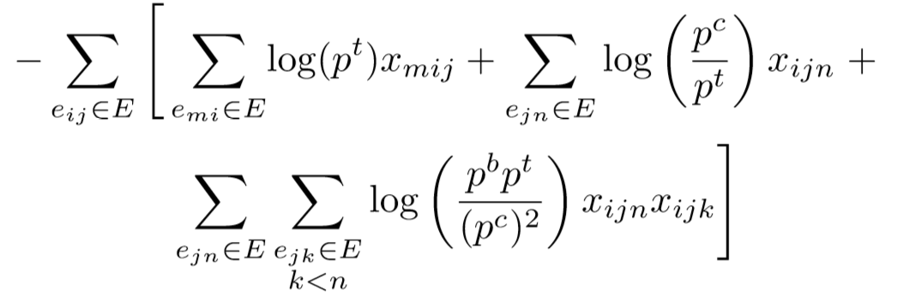
2nd term – Penalizes unlikely bifurcations and terminations
2nd log likelihood term simplifies to

Slide 14
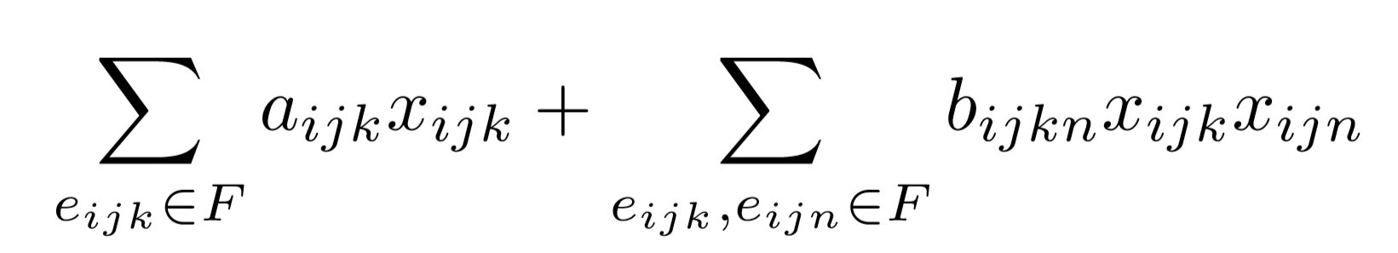
Objective Function to Minimize
From 1st log likelihood term: cost accounting quality of shortest path associated with edge pair e_{ijk}
From 2nd log likelihood term: penalizes unwarranted splits and loops

Slide 15
Constraints
Non-isolated seeds
Disjoint edges
Crossover consistency
Connectedness

Slide 16
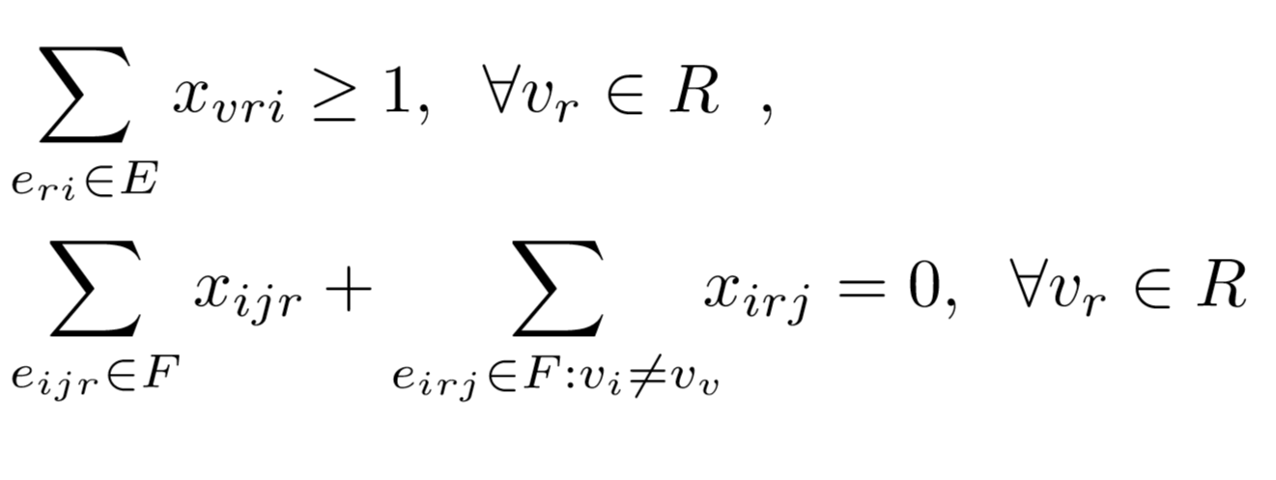
Non-isolated seeds

Slide 17
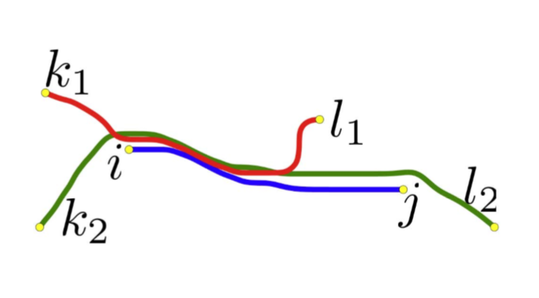
Disjoint Edges
If edges are overlapping too much, only ONE edge can be active
Only one edge from (k1, l1), (k2, l2), and (i, j) shown below can be active
For curvilinear structures that are inherently trees, this makes recovery easier
You can start from terminal vertices and follow edges that lead to the root vertices

Slide 18
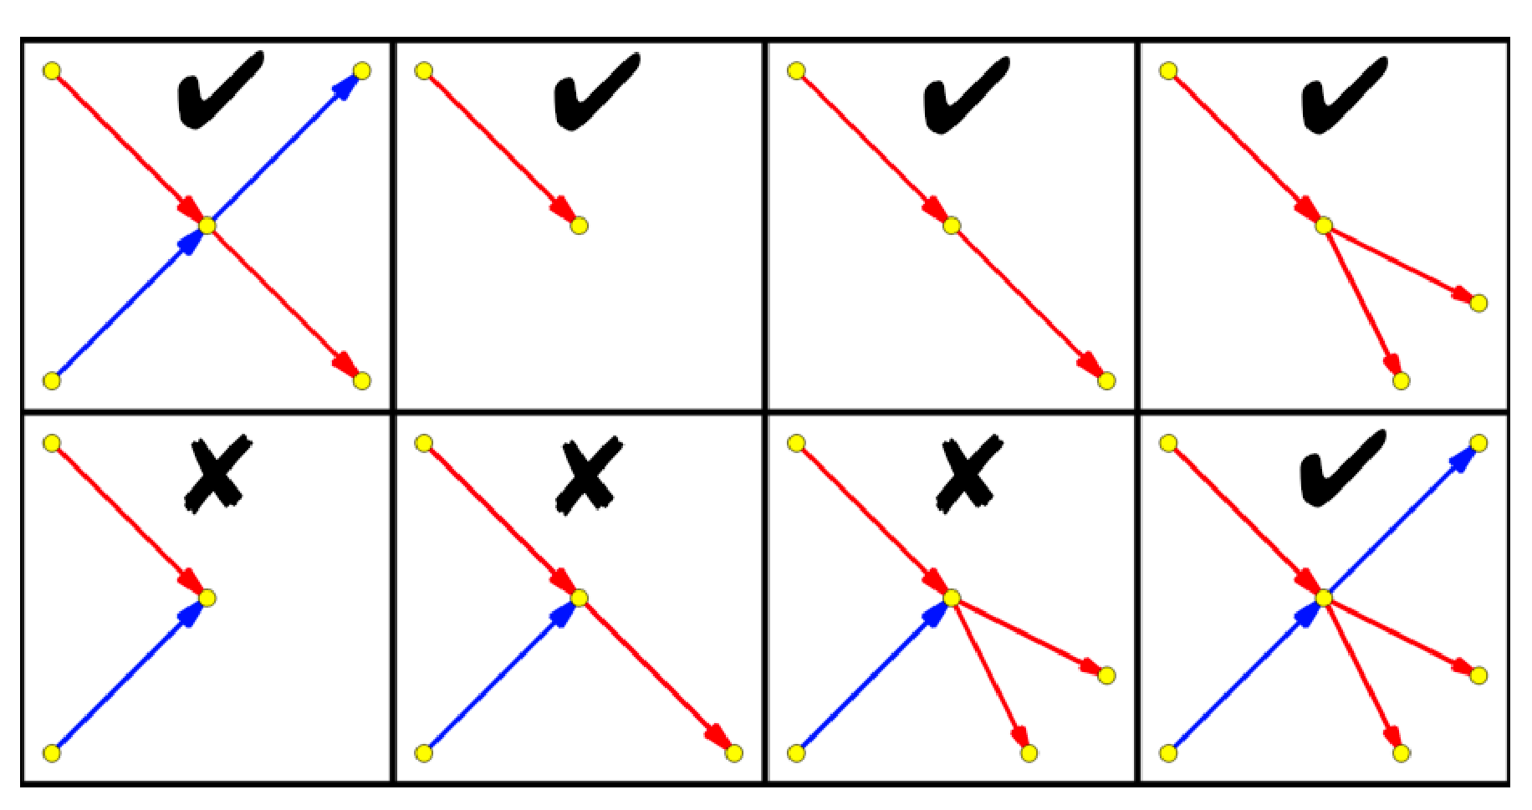
Crossover Consistency
-What goes in must go out! Unless it is a single termination
-Only activated for structures that were inherently trees

Slide 19
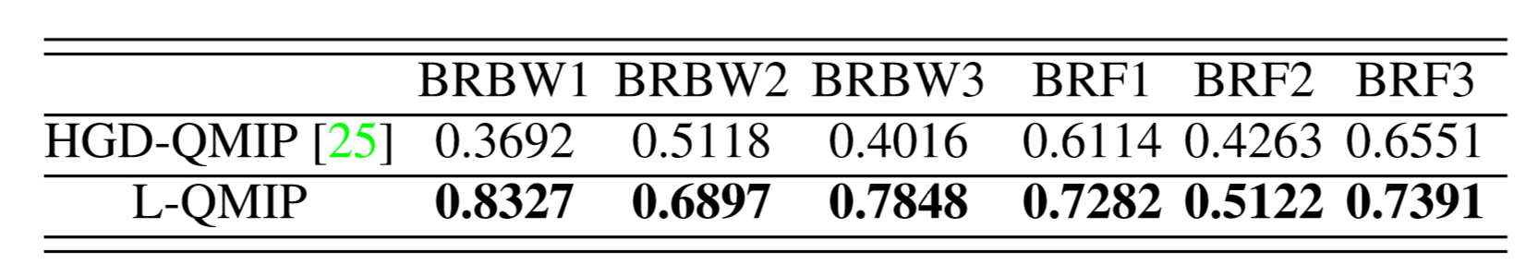
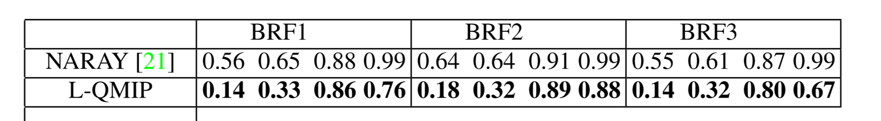
Results
DIADEM scores for HGD-QMIP vs. L-QMIP. Higher values are better!
Results for 1) geometric False Positive Rate, 2) geometric False Negative Rate, 3) connectivity False Positive Rate, and 4)connectivity False Negative Rate. Lower values are better here!

Slide 20
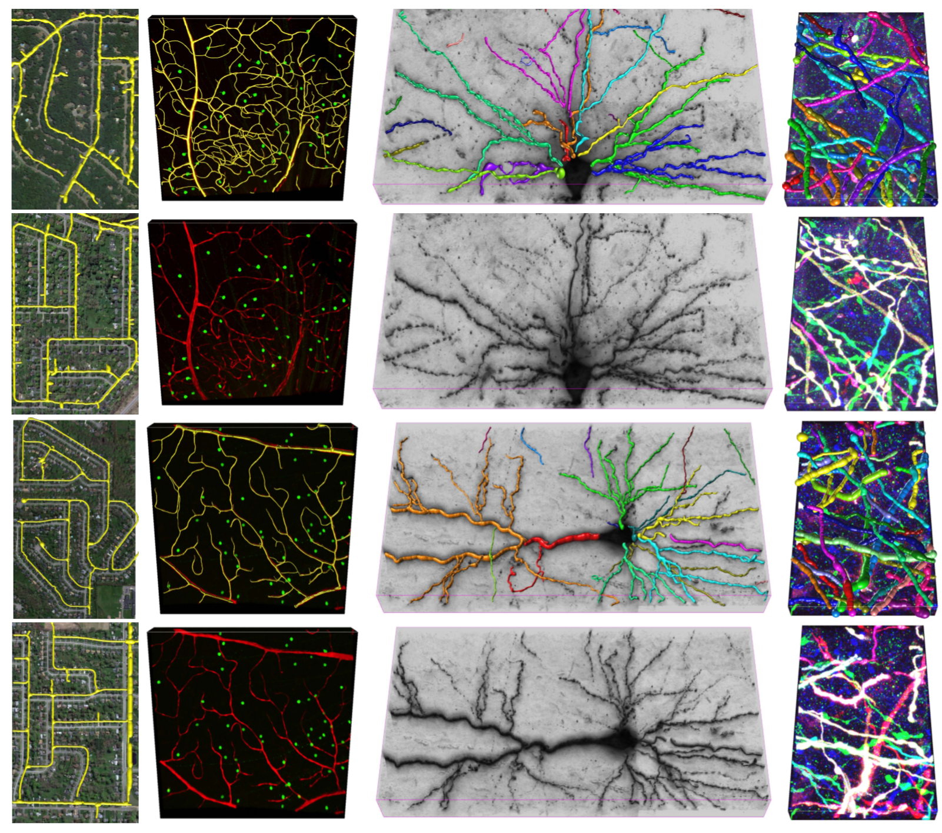

Slide 21
Future Thoughts
Will evaluating images as having loops always be better?
What potential drawbacks may exist to this method?
Were the results really convincing?
Will certain structures cause problems in this method?
Trees with loops?

Slide 22
Thank You!

